Slide 1
GTU Internship Of Tatvasoft
ENROLLMENT NO:190200107136
NAME:AJAY TARAPARA
SEM:8TH
BRANCH:COMPUTER ENGINEERING
COLLEGE: GEC RAJKOT
TACHNOLOGY:SOFTWARE ENGINEERING(dotnet)

Slide 2
ABOUT TRAINING
COMPANY:TATVASOFT MNC LEVEL-3
TECHNOLOGY:DOTNET,SQL,JAVASCRIPT,HTML,CSS,Jquery
LOCATION:RAJKOT(RK EMPIRE)
TRAINING PERIOD:SIX MONTHS
PROJECT NAME:CI-PLATEFORM
TAVA-MENTOR:SWEETY PATEL AND VISHAL SOLANKI
CO-ORDINATOR:RAHUL KUMBHARVADIYA
INTERNAL GUIDE:T.M. KODINARIYA

Slide 3
WEEKLY REPORTS OF INTERSHIP
WEEK-1
WEEK-5
WEEK-2
WEEK-6
WEEK-3
WEEK-7
WEEK-4
WEEK-8

Slide 4
1ST WEEK OF TRAINING
ON FIRST DAY I WATCHED VIDEOS OF CI-SRS DOCUMENT AND GET IDEA ABOUT OUR PROJECT .
WATCHED VIDEOS OF PROJECT REQUIREMENT AND FEATURES OF PROJECT .
IN MEETING WE DISSCUSSED THE PROJECT AND THEIR PROTOCOL STACK
WE GET CIRCULAR OF TRAINING PLAN.
SECOND DAY WE WATCHED VIDEOS OF GIT AND GIT HUB .
I GOT KNOWLEDGED ABOUT IT AND IMPORTANCE IN THE CODING LIFE.
THIRD DAY WE IMPLEMENT THE BASIC GIT COMMANDS AND MAKE OUR OWN REPOSITORY.

Slide 5
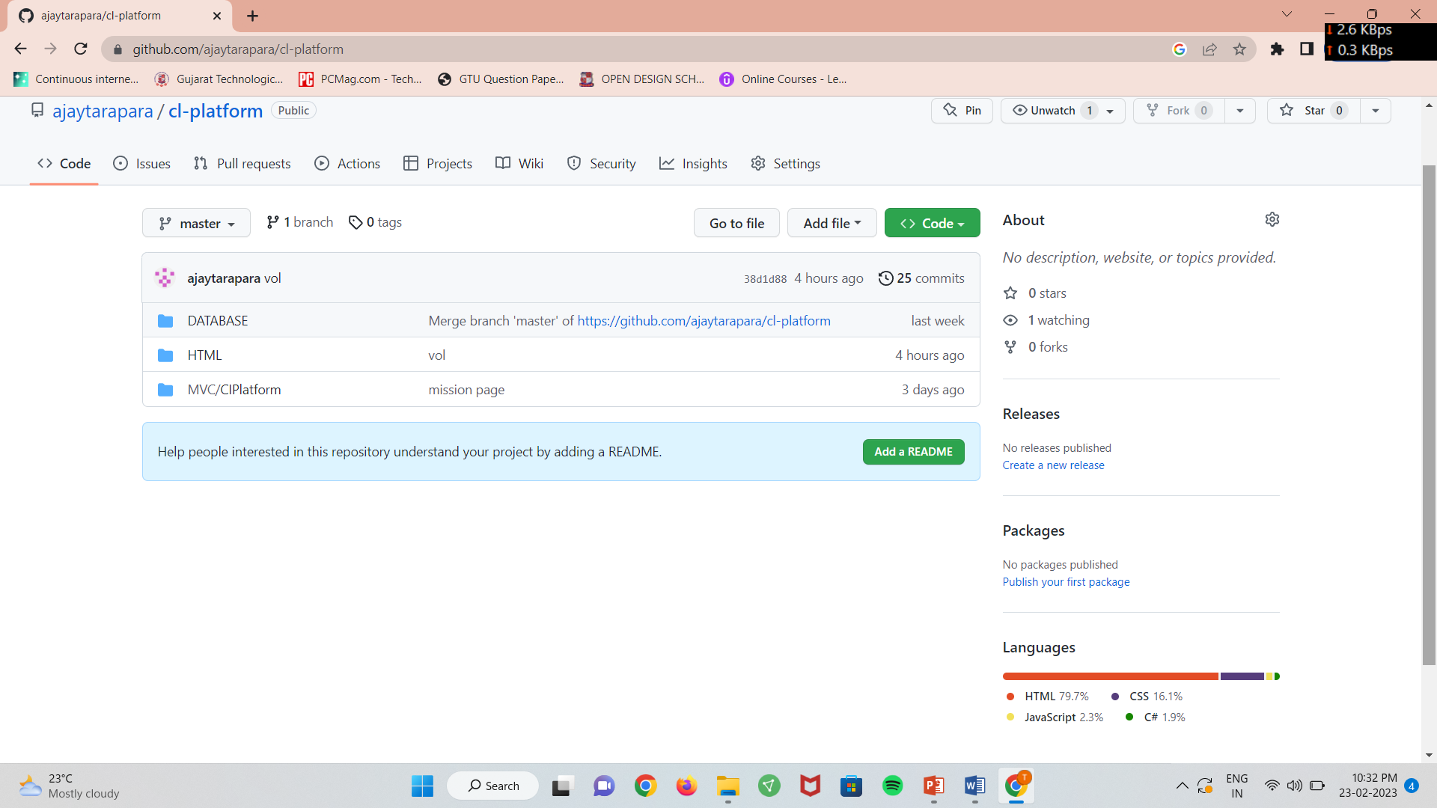
Git repository img.

Slide 6
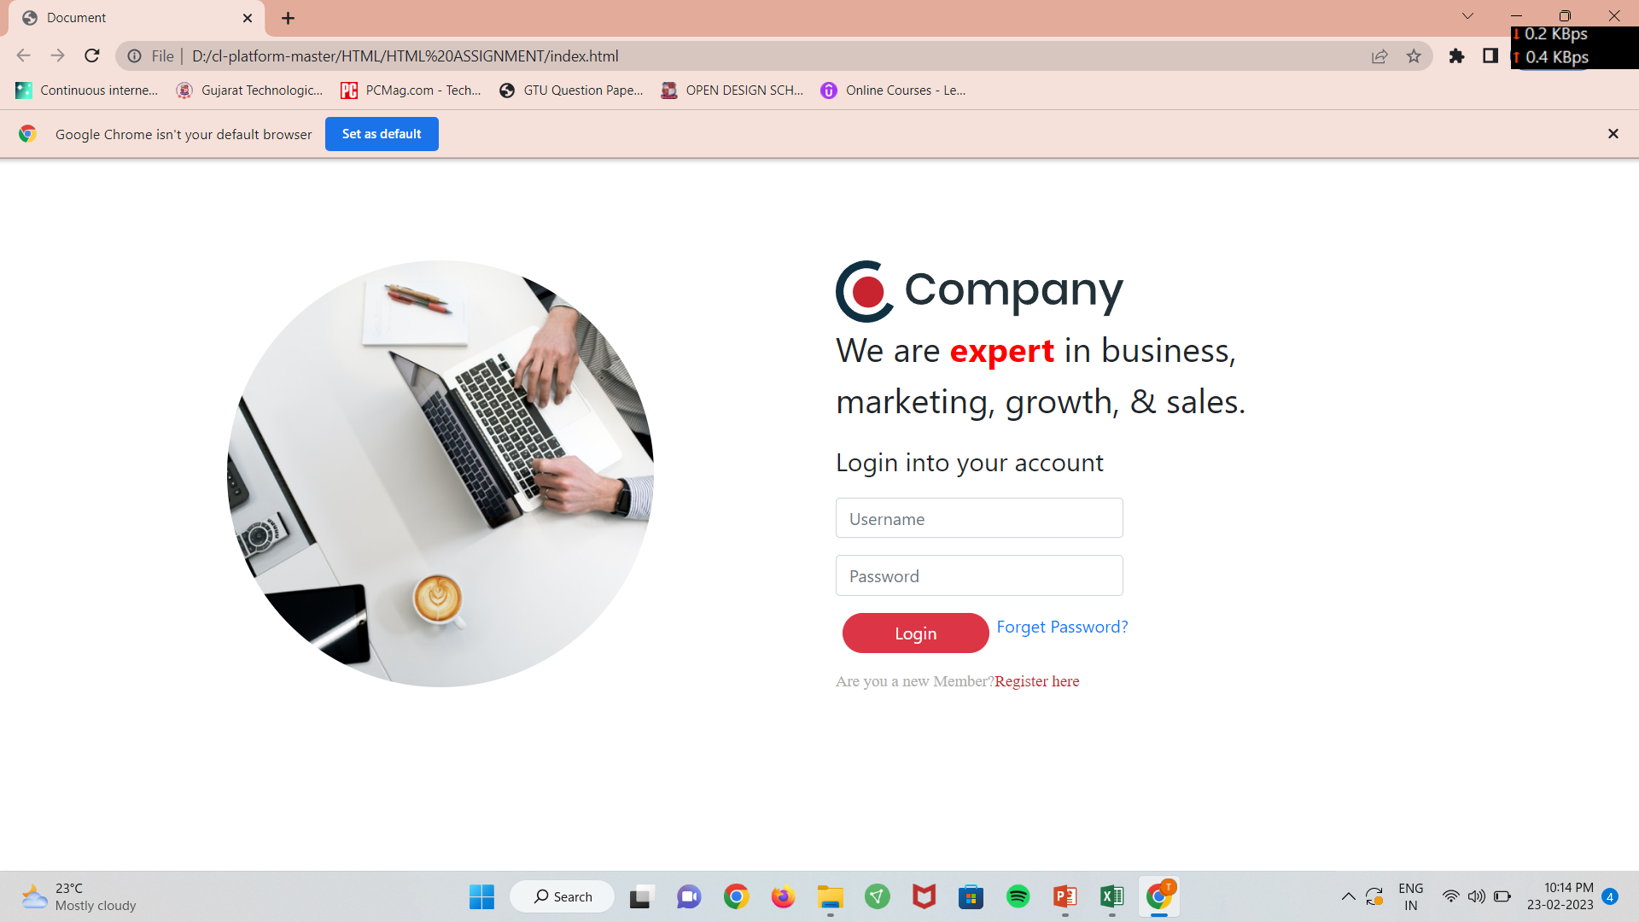
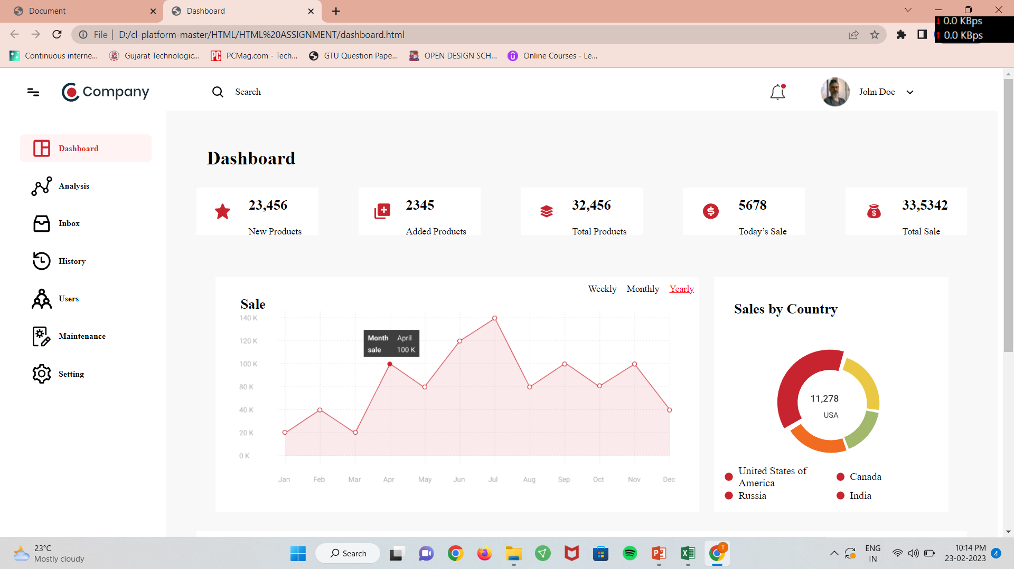
HTML PAGES PHOTOS.
LOGIN DASHBOARD

Slide 7
FOURTH DAY I STARTED TO WATCHED VIDEOS OF BASIC HTML AND CSS.
COMPLETED FIRST ASSIGNMENT OF HTML.
THIS IS A STATIC PAGE OF WEBSITE.
BACK TO INDEX

Slide 8
2ND WEEK OF INTERNSHIP
IN THIS WEEK WE TARGETED WORKED ON HTML,CSS,JAVASCRIPT AND BOOTSTRAP.
I IMPLEMENT WEB PAGES USING CSS AND HTML THIS IS STATIC PAGES
AFTER WE TARGETED TO MAKE IT FULLY RESPONSIVE.
I COMPLETED HTML ASSIGNMENT 1-4 IN THIS WEEK .
AND ALSO MAKE IT RESPONSIVE TILL 360 PX MEDIA SCREEN .
STARTED TO WATCH SQL SERVER VIDEOS.
INNERPAGE
BACK TO INDEX

Slide 9
3RD WEEK OF INTERNSHIP
WORKED ON MY PROJECT FIRST FOUR PAGES.
MAKE IT FULLY RESPONSIVE USING BOOTSTRAP AND CSS.
I IMPLEMENTED LOGIN , FORGOT PASSWORD ,RESET PASSWORD AND REGISTRATON.
IMPLEMENT SQL IN SERVER AND COMPLETED ITS ASSIGNMENT 1 AND 2.
IT IS COMPLETED USING BASIC OF SQL COMMAND .LIKE CREATE ,ALTER,INSERT, DROP AND GROUP BY CLAUSE.
SQL 3 AND 4 TH ASSIGNMENT COMPLETED USING JOINS AND STORAGE PROCEDURES AND TRIGGERS.

Slide 10
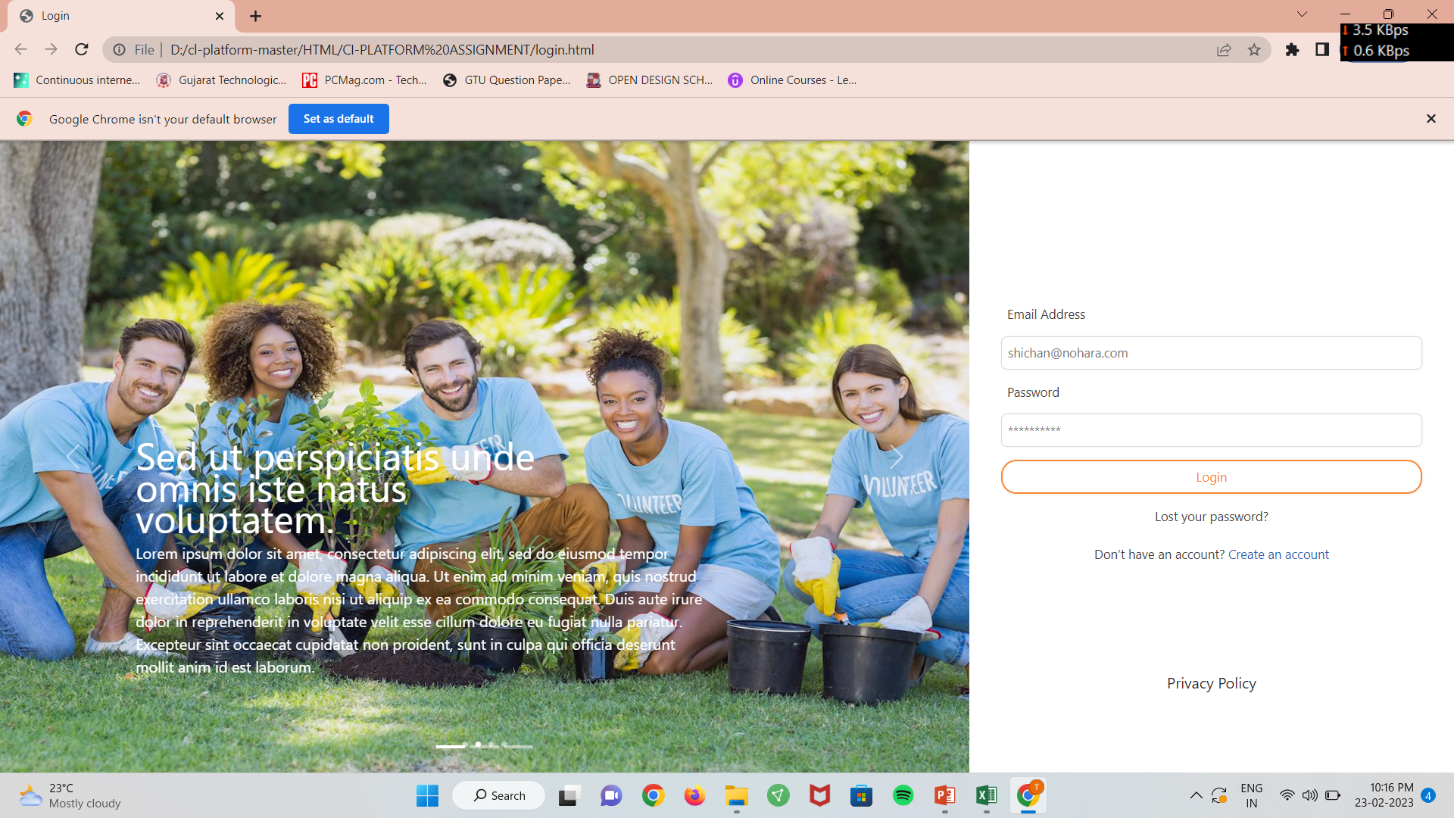
LOGIN PAGE OF CI-PLATEFORM
LOGIN PAGE OF CI

Slide 11
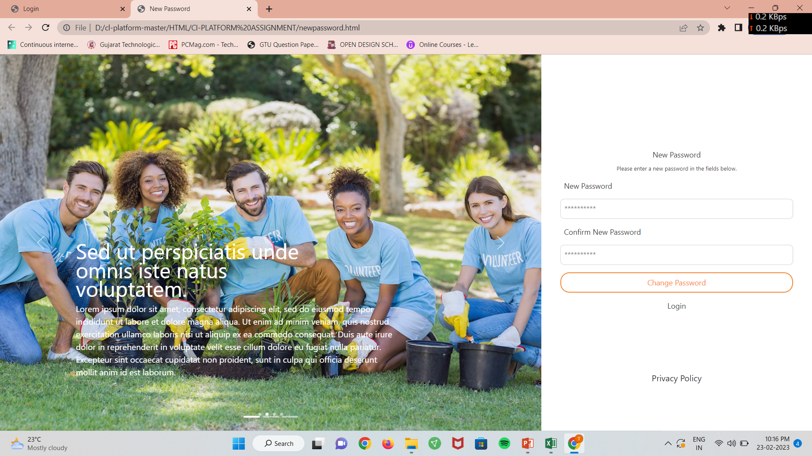
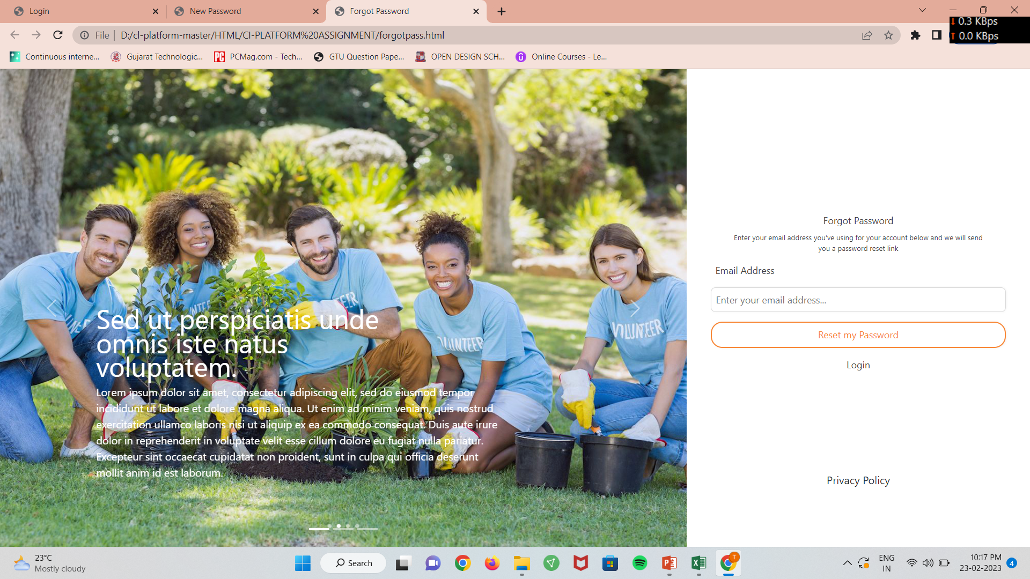
RESET AND FORGOT PASSWORD PAGES
RESET PASSWORD
FORGOT PASSWORD

Slide 12
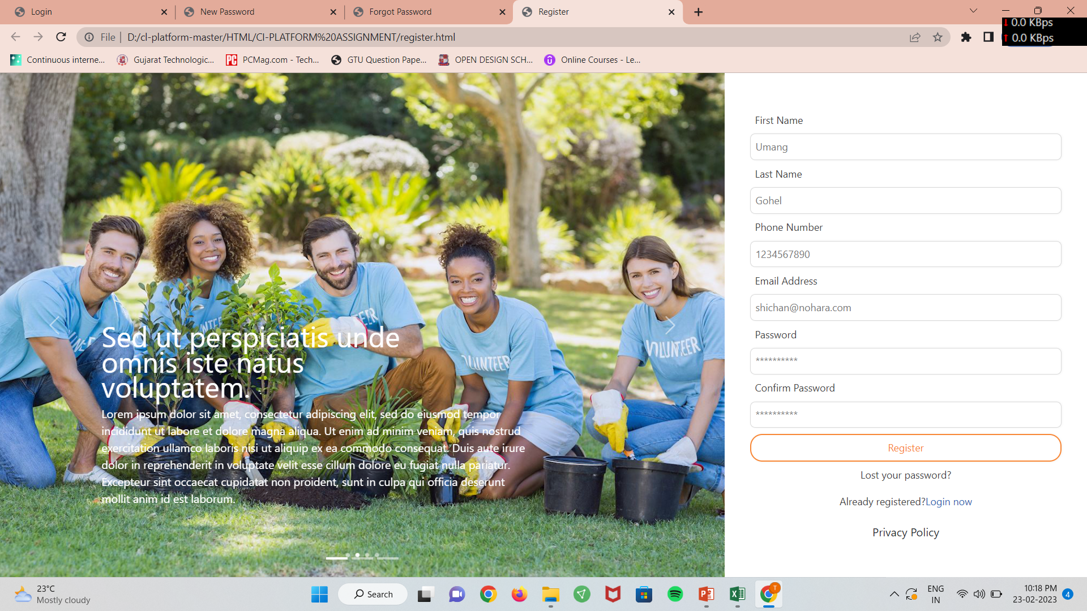
REGISTRATION PAGE OF CI PLATFORM.
REGISTRATION PAGE
BACK TO INDEX

Slide 13
4TH WEEK OF INTERNSHIP
IN THIS WE TRAGET THE COMPLETED OUR CI PLATFORM RESPONSIVE PAGES AND WATCHED VIDEOS OF MVC .
USING MVC CORE WE CONVERT OUR HTML PAGES IN TO MVC UI.
IN THIS WEEK WE CONVERT LOGIN , RESET PASSWORD , FORGOT PASSWORD AND REGISTRATION IN MVC UI.
IT IS PERFORMED IN VS CODE.
I MADE THE DB SCHEMA OF CI-PLATEFORM EXCEL SHEET AND SQL SCHEMA FOR CI PLATEFORM IN SQL SERVER.

Slide 14
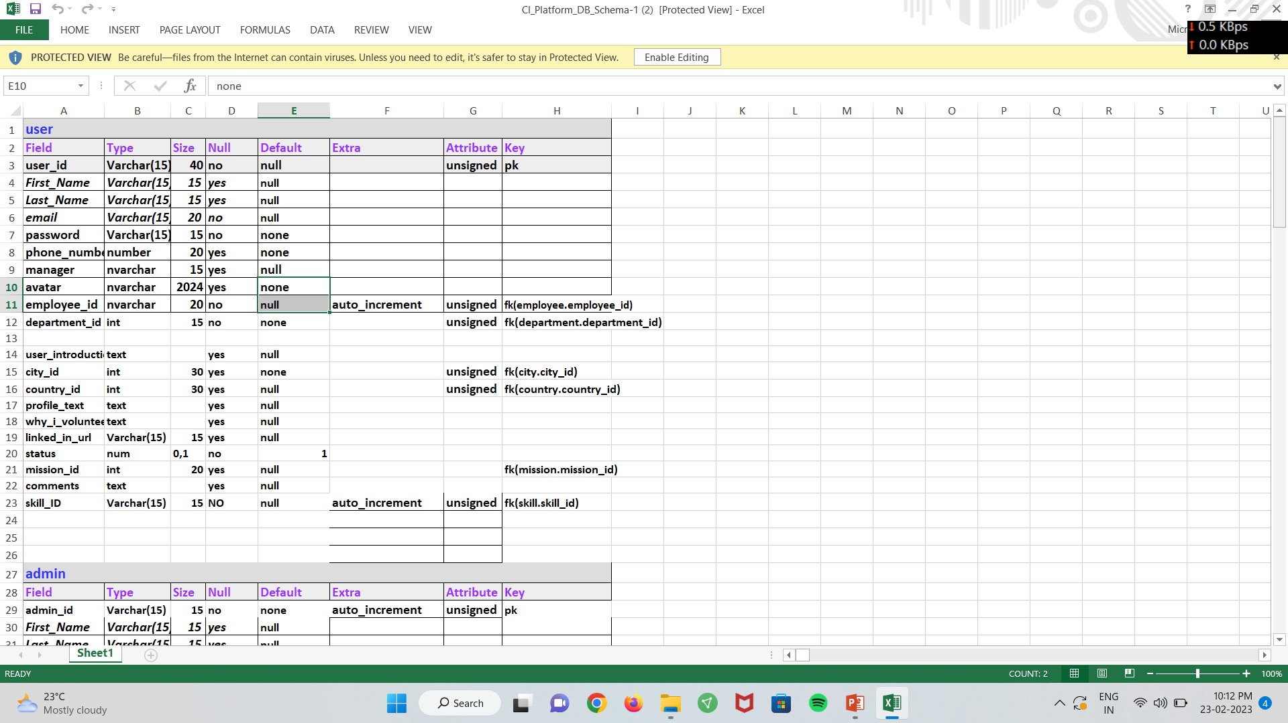
DB SCHEMA XLS SHEET
DB XL SHEET OF CI

Slide 15
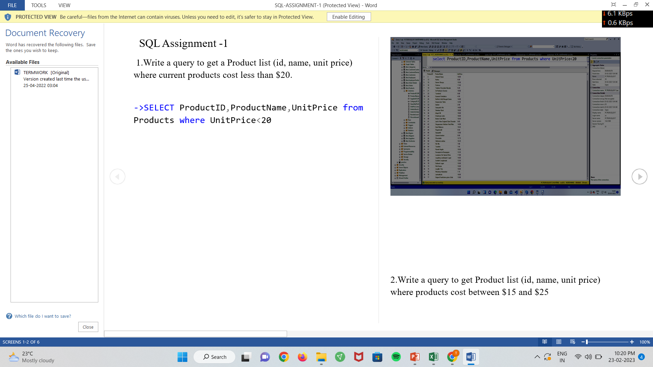
DATA BASE ASSIGNMENT
DB ASSIGNMENT-1

Slide 16
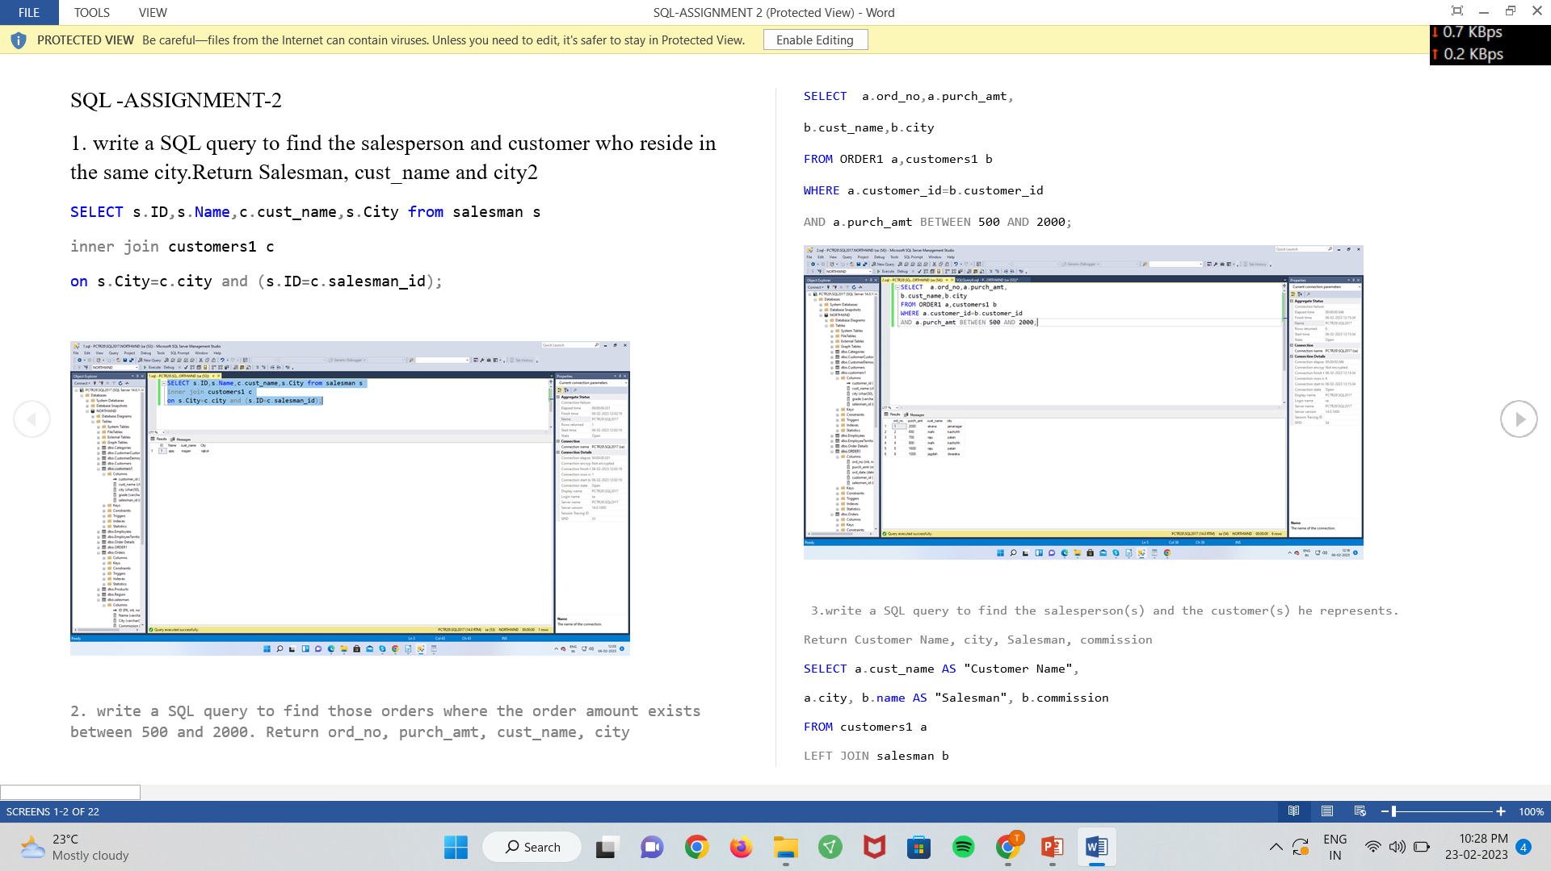
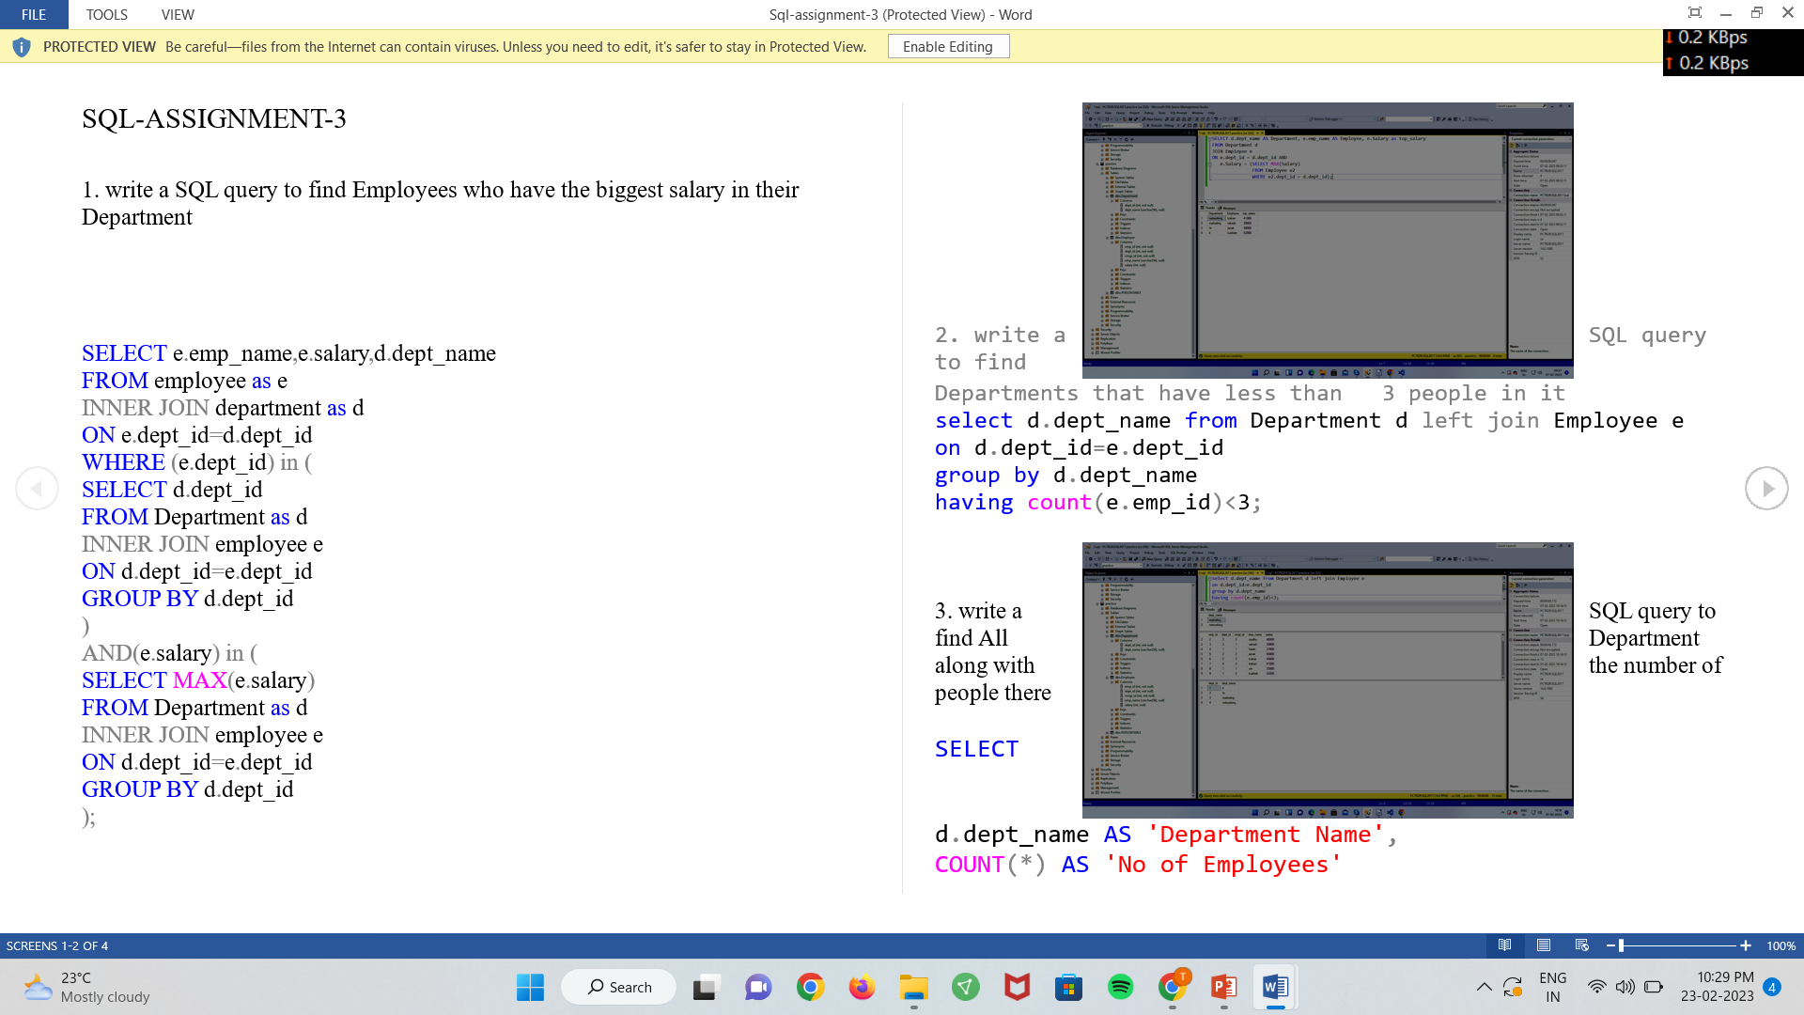
DB ASSIGNMENTS IN SQL SERVER.
ASSIGNMENT-2 ASSIGNMENT-3

Slide 17
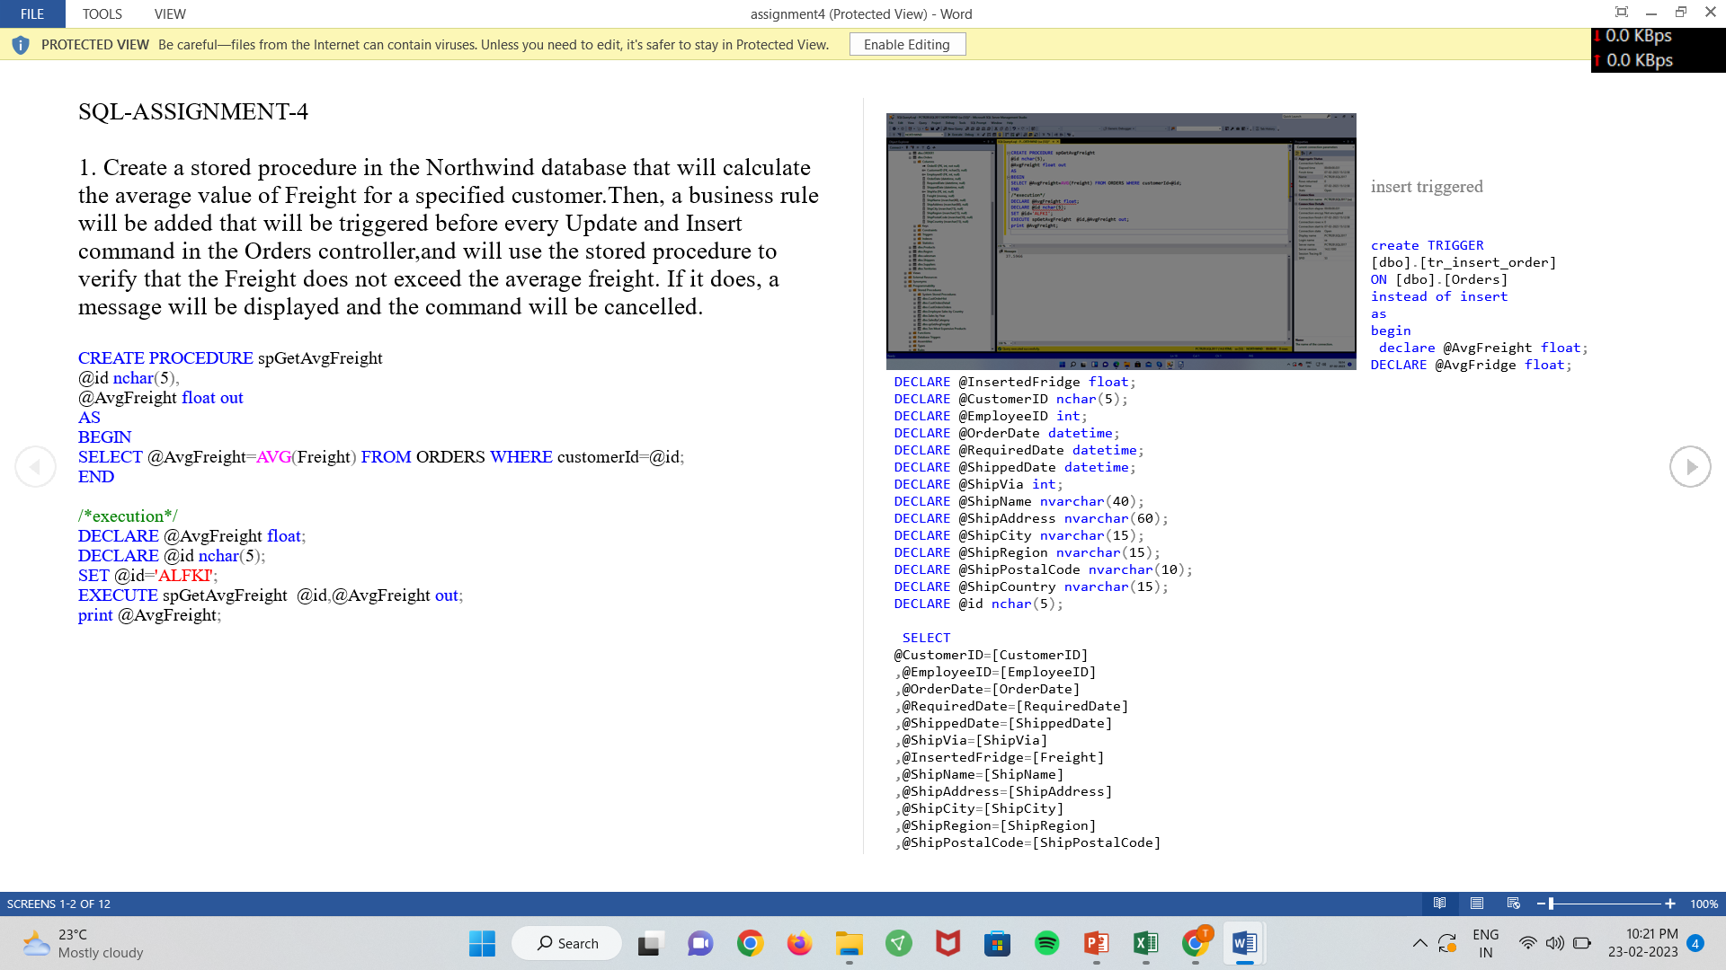
STORAGE PROCEDURE IN DB AND TRIGGERS ASSIGNMENT.
ASSIGNMENT-4
BACK TO INDEX

Slide 18
5TH WEEK OF INTERNSHIP
IN THIS WEEK , I WORKED ON CI PLATFORM FRONTEND SIDE PAGES USING HTML,CSS, JAVASCRIPT.
I IMPLEMENT HOME PAGE AND THEIR GRID VIEW OF MISSION AND LIST VIEW OF MISSON.
I WATCHED VIDEOS OF N-TIER ARCHITECTURE OF DOTNET PROJECT AND UNDERSTAND IMPORTANCE OF IT.
IN THIS WEEK I ALSO IMPLEMENT MISSION VOLUNTEERING PAGE.
MISSION VOL.PAGE MAKE IT FULLY RESPONSIVE TILL 360PX.

Slide 19
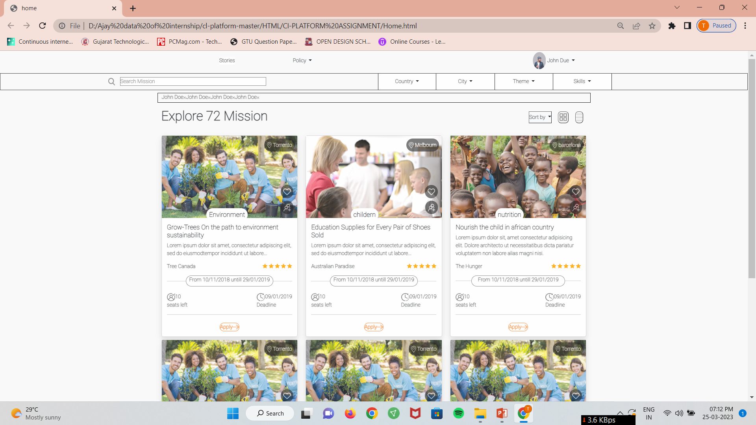
HOME PAGE OF CI

Slide 20
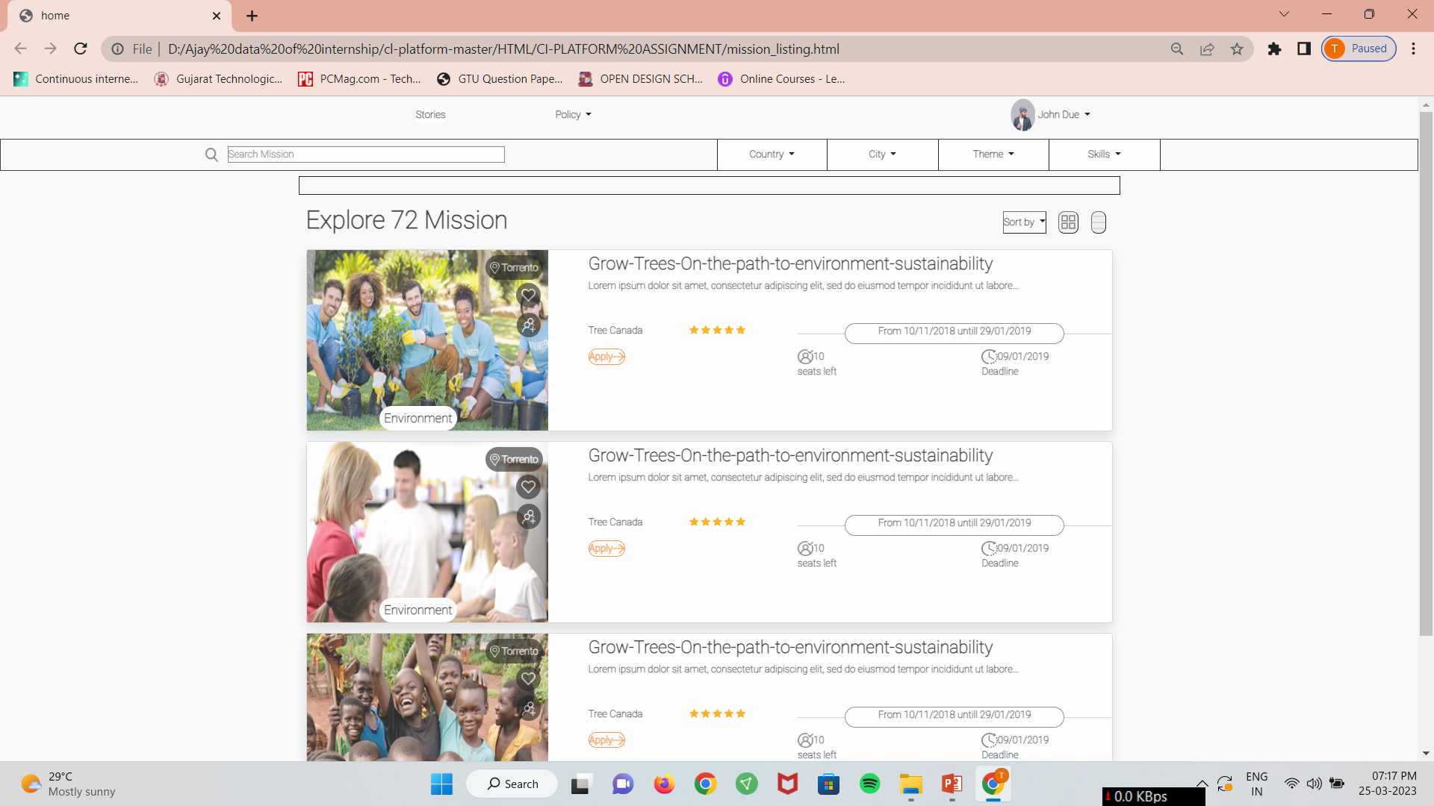
LIST VIEW

Slide 21
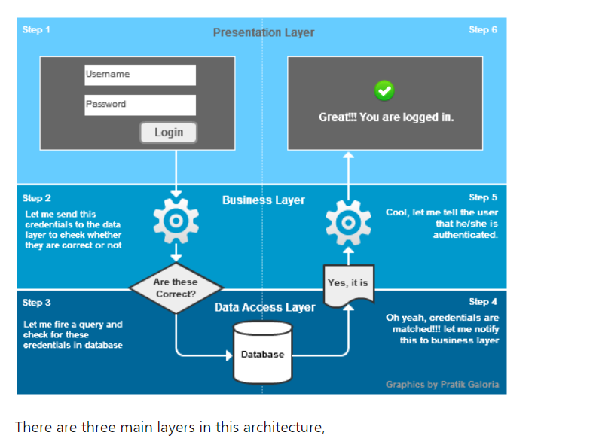
N-TIER ARCHITECTURE OF PROJECT
BACK TO INDEX

Slide 22
6TH WEEK OF INTERNSHIP
IN THIS WEEK I WORKED ON FRONTEND SIDE VALIDATION OF LOGIN PAGE AND REGISTRATION PAGE
I WATCHED VIDEOS OF ASP.NET DATABASE INTIGRTAION.
I INTEGRATED DB WITH HTML PAGES WITH 3 TIER ARCHITECTURE OF PROJECT.
I ALSO WORKED ON FORGOT PASSWORD AND NEW PASSWORD PAGES FOR DB INTIGRATION FOR BACKEND SIDE.
I ATTEND EXPERT SESSION OF JAVASCRIPT AND JQUERY.

Slide 23
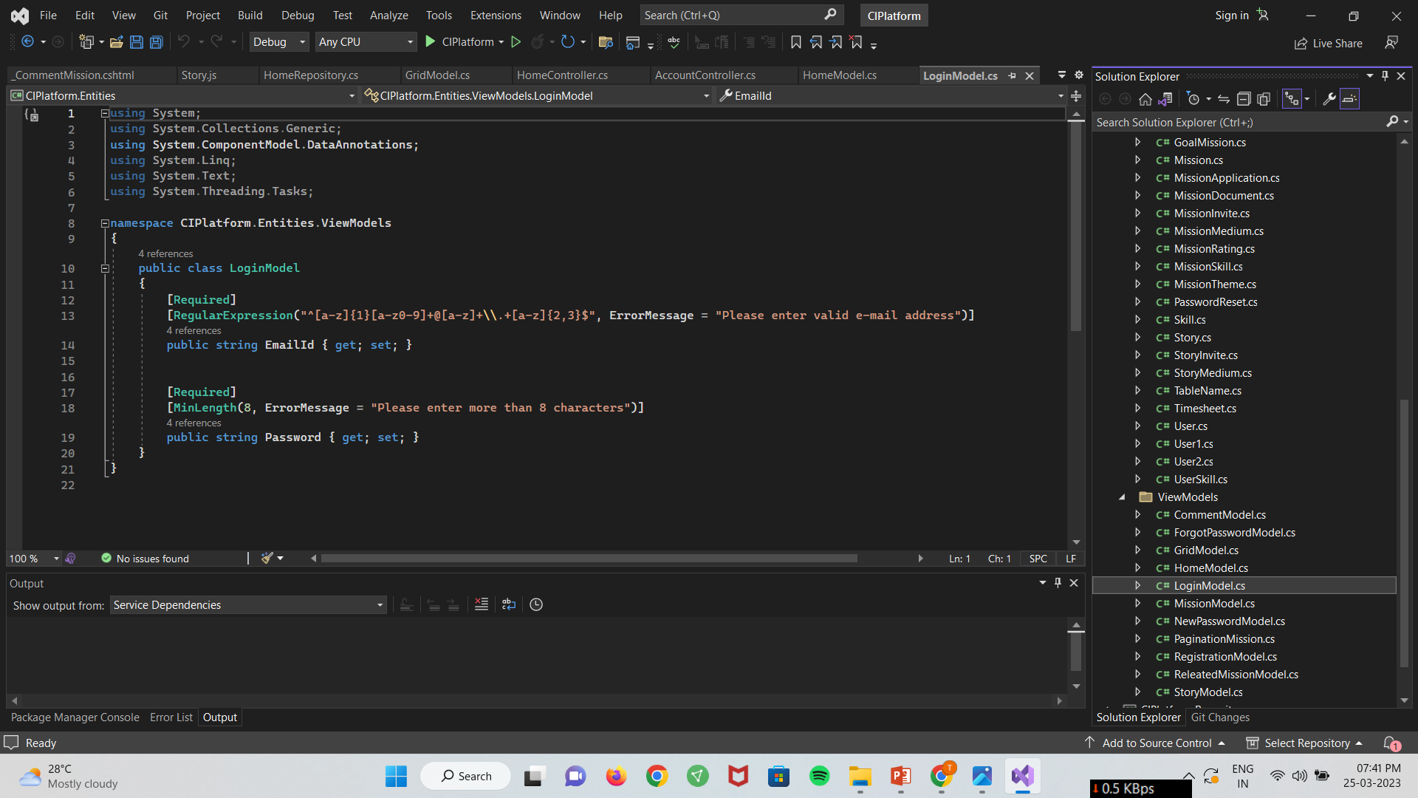
HOME AND REGISTRATION PAGE VALIDATION .

Slide 24
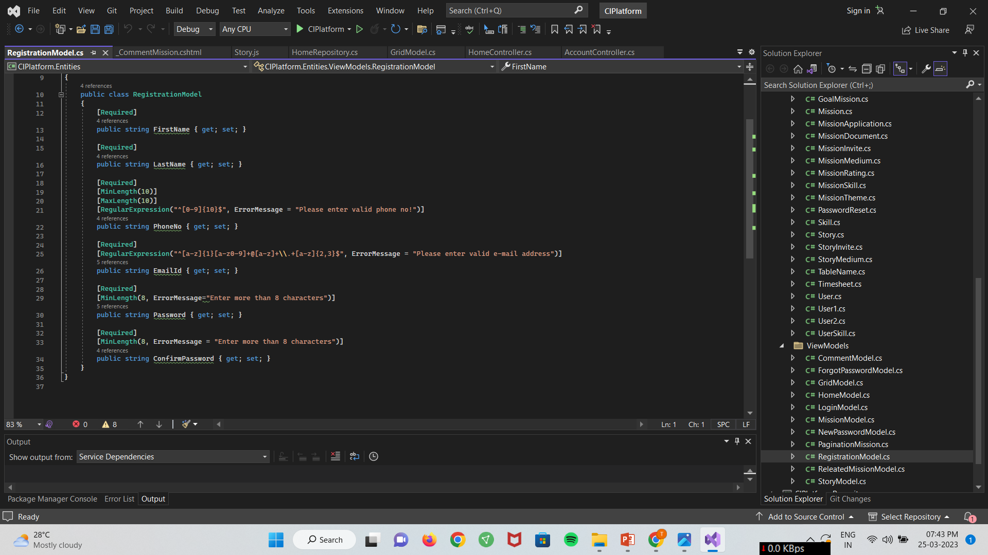

Slide 25
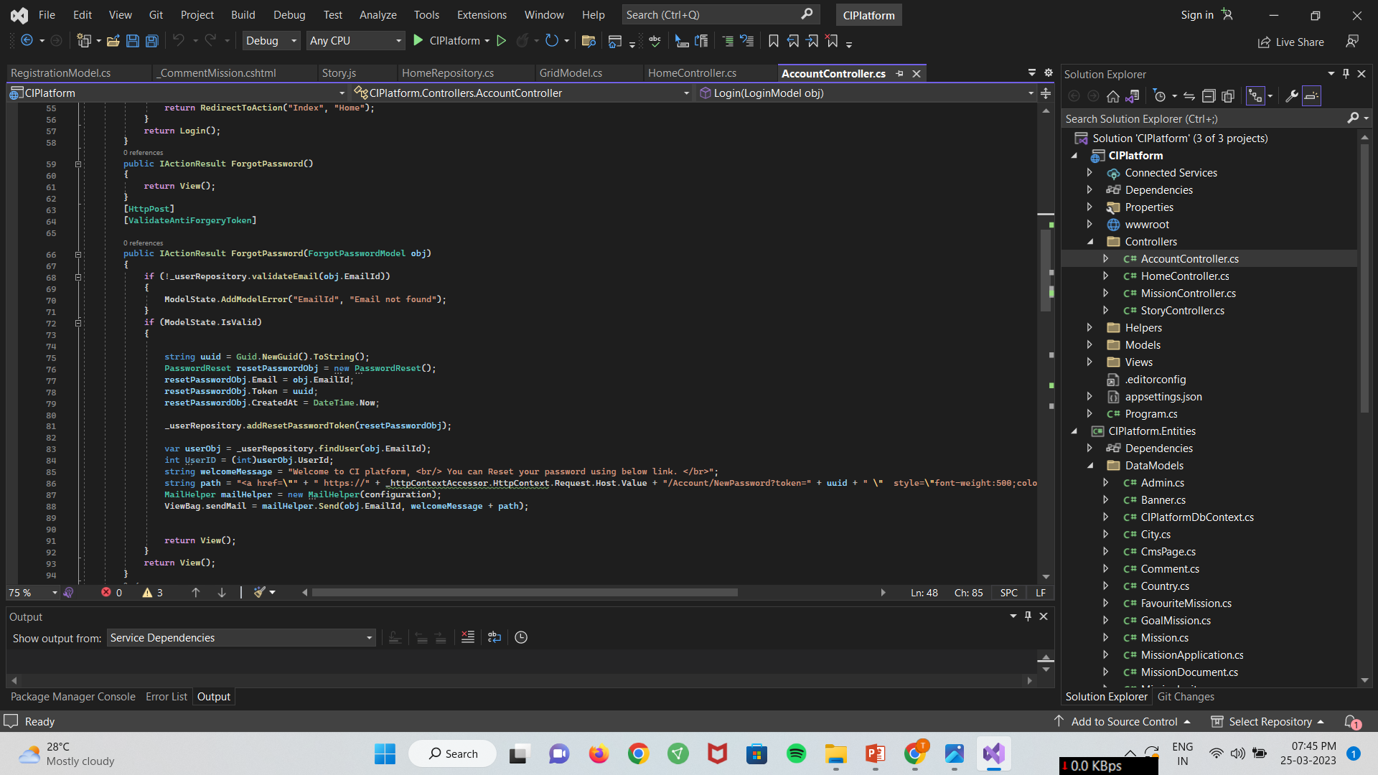
FORGOT PASSWORD AND NEW PASSWORD VALIDATION AND INTIGRATION.

Slide 26
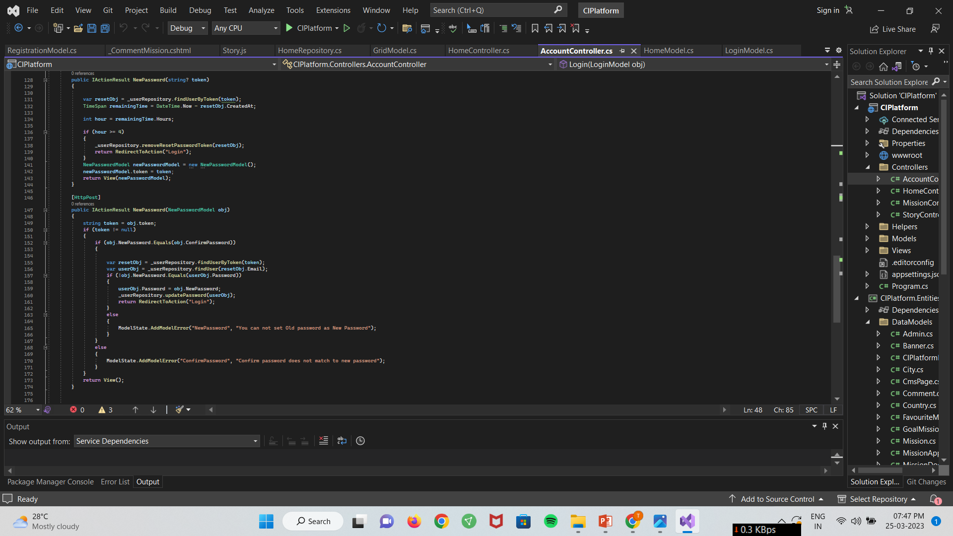
BACK TO INDEX

Slide 27
7TH WEEK OF INTERNSHIP
IN THIS I WORKED ON INTEGRATION OF HOME PAGE WITH DB.
I ALSO WATCHED VIDEOS OF ASP.NET MVC
I CREATED STORE PROCEDURE FOR DATA COLLECT FROM DATABASE.
I IMPLEMENT HOMEPAGE HEADER WITH SESSION .
I ALSO IMPLEMENT AJAX CALL FOR HOME PAGE FILTERS AND GRIDVIEW AND LISTVIEW DATA APPEND IN HTML PAGE WITHOUT REFRESHING IT .
BACK TO INDEX

Slide 28
8TH WEEK OF INTERNSHIP
IN THIS WEEK I IMPLEMENT SP FOR FILTER AND AJAX CALL .
I ASLO WORK FOR SEARCHING FUNCTIONALITY USING SP AND AJAXCALL.
AND APPEND DATA IN TO HTML OR FRONEND SIDE.
I ALSO GET DATA FOR GRID AND LIST VIEW .
I WORK ON PAGINATION FROM BACKEND SIDE USING SP.
AND IMPLEMENT IT ON FRONEND SIDE.
I ALSO IMPLEMENT ADD TO FAVOURITE MISSION AND DB INTEGRATION FOR IT.
BACK TO INDEX

Slide 29
THANK YOU

